Slide 1
Module -1
Java
Write Once, Run Anywhere
Dr Sumit Badotra

Slide 2
Java - General
Java is:
  platform independent programming language
  similar to C++ in syntax
  a high-level, general-purpose, object-oriented, and secure programming language developed by James Gosling at Sun Microsystems,

Slide 3
Java - Editions
Each edition of Java has different capabilities. There are three editions of Java:
Java Standard Editions (JSE): It is used to create programs for a desktop computer.
Java Enterprise Edition (JEE): It is used to create large programs that run on the server and manages heavy traffic and complex transactions.
Java Micro Edition (JME): It is used to develop applications for small devices such as set-top boxes, phone, and appliances.

Slide 4
Features of Java
Simple
Robust (Java makes an effort to check error at run time and compile time. It uses a strong memory management system called garbage collector
OOPs
Multithreading
Secure (Java contains a security manager that defines the access of Java classes)
Platform Independent

Slide 5
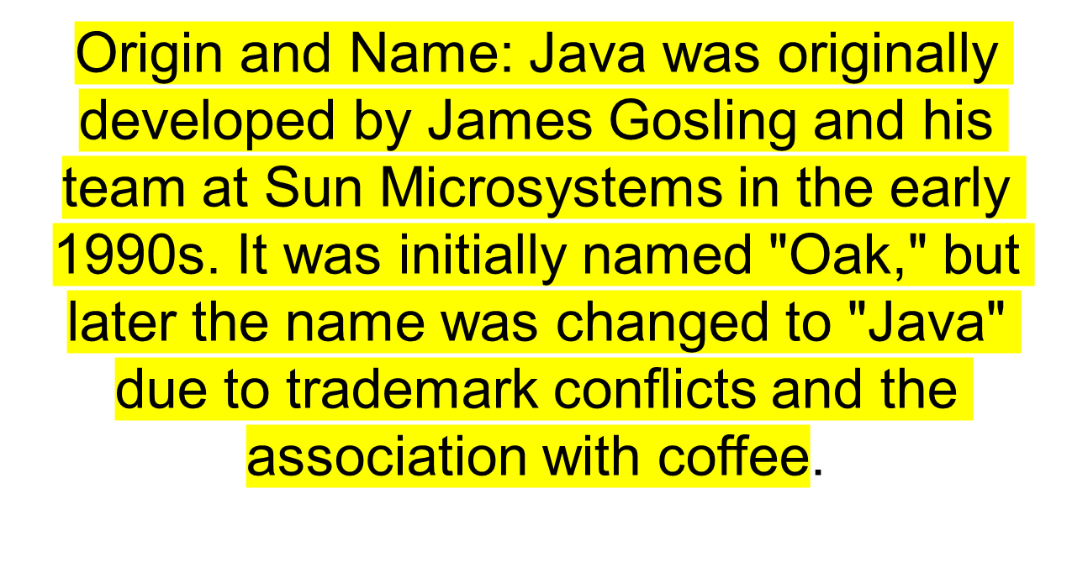
Do you Know?

Slide 6
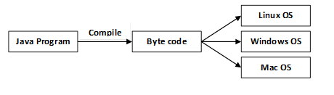
Java Platform independency

Slide 7
How it works…!
Compile-time Environment
Compile-time Environment
Class Loader
Bytecode
Verifier
Java Class
Libraries
Java
Source
(.java)
Java
Interpreter
Just in Time
Compiler
Java
Bytecodes
move locally
or through
network
Java
Virtual
machine
Java
Compiler
Runtime System
Java
Bytecode
(.class )
Operating System
Hardware

Slide 8
JVM
The Java Virtual Machine (JVM) is an integral part of the Java Runtime Environment (JRE) and serves as the runtime engine for Java applications.
It is a virtual machine that enables the execution of Java bytecode, which is a compiled form of Java source code.
The primary purpose of the JVM is to provide a platform-independent and secure environment for running Java programs.

Slide 9
How it works…!
Java is independent only for one reason:
  Only depends on the Java Virtual Machine (JVM),
  code is compiled to bytecode, which is interpreted by the resident JVM,
  JIT (just in time) compilers attempt to increase speed.

Slide 10
Java Advantages
Portable - Write Once, Run Anywhere
Security has been well thought through
Robust memory management
Designed for network programming
Multi-threaded (multiple simultaneous tasks)
Dynamic & extensible (loads of libraries)
  Classes stored in separate files
  Loaded only when needed

Slide 11
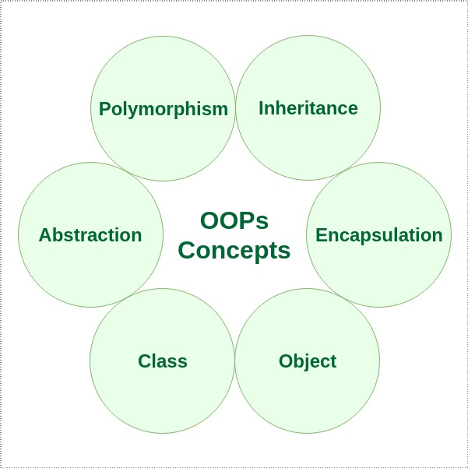
OOPs in Java

Slide 12
Object-Oriented
Java supports OOD
  Polymorphism
  Inheritance
  Encapsulation
Java programs contain nothing but definitions and instantiations of classes
  Everything is encapsulated in a class!

Slide 13
Basic Java Syntax

Slide 14
Example
Simple.java
class Simple{
public static void main(String args[]){
System.out.println("Hello Java");
}
}

Slide 15
Java Operators
Operator in Java is a symbol that is used to perform operations. For example: +, -, *, / etc.
There are many types of operators in Java which are given below:
Unary Operator,
Arithmetic Operator,
Shift Operator,
Relational Operator,
Bitwise Operator,
Logical Operator,
Ternary Operator and
Assignment Operator.

Slide 16

Unary Operator
The Java unary operators require only one operand. Unary operators are used to perform various operations i.e.:
incrementing/decrementing a value by one
negating an expression
inverting the value of a boolean

Slide 17
Example
public class OperatorExample{
public static void main(String args[]){
int x=10;
System.out.println(x++);
System.out.println(++x);
System.out.println(x--);
System.out.println(--x);
}}
Notes:
10 12 12 10

Slide 18
Example 2
public class OperatorExample{
public static void main(String args[]){
int a=10;
int b=10;
System.out.println(a++ + ++a);
System.out.println(b++ + b++);
}}
Notes:
10+12=22 10+11=21

Slide 19
Example 3
public class OperatorExample{
public static void main(String args[]){
boolean c=true;
boolean d=false;
System.out.println(!c);//false (opposite of boolean value)
System.out.println(!d);//true
}}

Slide 20
Arithmetic Operator
Java arithmetic operators are used to perform addition, subtraction, multiplication, and division. They act as basic mathematical operations.

Slide 21
Example
public class OperatorExample{
public static void main(String args[]){
int a=10;
int b=5;
System.out.println(a+b);//15
System.out.println(a-b);//5
System.out.println(a*b);//50
System.out.println(a/b);//2
System.out.println(a%b);//0
}}

Slide 22
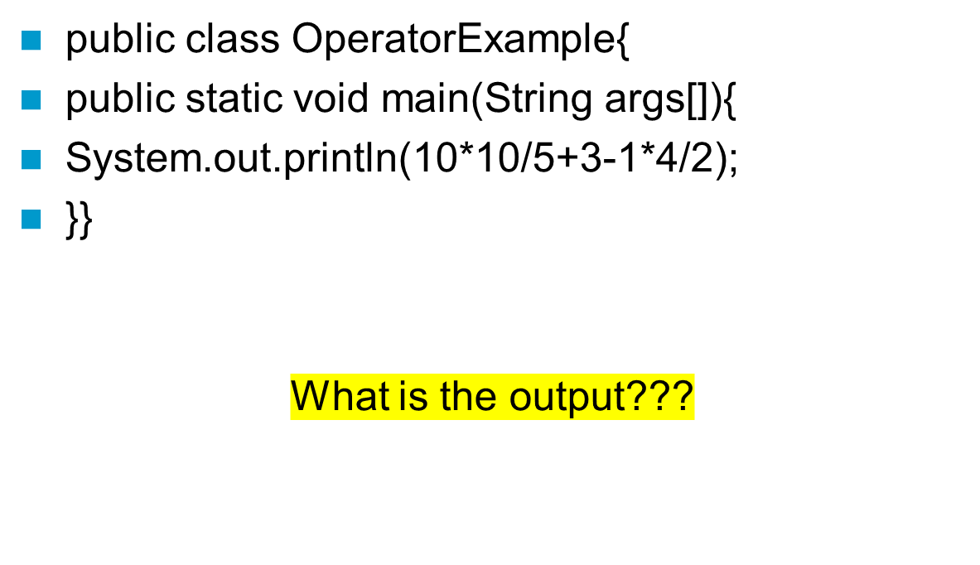
Statements & Blocks
Notes:
21

Slide 23
Java Left Shift Operator
The Java left shift operator << is used to shift all of the bits in a value to the left side of a specified number of times.

Slide 24
Example
public class OperatorExample{
public static void main(String args[]){
System.out.println(10<<2);//10*2^2=10*4=40
System.out.println(10<<3);//10*2^3=10*8=80
System.out.println(20<<2);//20*2^2=20*4=80
System.out.println(15<<4);//15*2^4=15*16=240
}}

Slide 25
Java Right Shift Operator
The Java right shift operator >> is used to move the value of the left operand to right by the number of bits specified by the right operand.
public OperatorExample{
public static void main(String args[]){
System.out.println(10>>2);//10/2^2=10/4=2
System.out.println(20>>2);//20/2^2=20/4=5
System.out.println(20>>3);//20/2^3=20/8=2
}}

Slide 26
Java Assignment Operator
Java assignment operator is one of the most common operators. It is used to assign the value on its right to the operand on its left.
public class OperatorExample{
public static void main(String args[]){
int a=10;
int b=20;
a+=4;//a=a+4 (a=10+4)
b-=4;//b=b-4 (b=20-4)
System.out.println(a);
System.out.println(b);
}}

Slide 27
Example
  public class OperatorExample{
  public static void main(String[] args){
  int a=10;
  a+=3;//10+3
  System.out.println(a);
  a-=4;//13-4
  System.out.println(a);
  a*=2;//9*2
  System.out.println(a);
  a/=2;//18/2
  System.out.println(a);
  }}

Slide 28
Java Ternary Operator
Java Ternary operator is used as one line replacement for if-then-else statement and used a lot in Java programming.
It is the only conditional operator which takes three operands.

Slide 29
Examples
public class OperatorExample{
public static void main(String args[]){
int a=10;
int b=5;
int min=(a<b)?a:b;
System.out.println(min);
}}
public class OperatorExample{
public static void main(String args[]){
int a=2;
int b=5;
int min=(a<b)?a:b;
System.out.println(min);
}}

Slide 30
Java Bitwise Operator
  The bitwise | operator always checks both conditions whether first condition is true or false.
  The logical || operator doesn't check the second condition if the first condition is true. It checks the second condition only if the first one is false.

Slide 31
Example
public class OperatorExample{
public static void main(String args[]){
int a=10;
int b=5;
int c=20;
System.out.println(a>b||a<c);//true || true = true
System.out.println(a>b|a<c);//true | true = true
//|| vs |
System.out.println(a>b||a++<c);//true || true = true
System.out.println(a);//10 because second condition is not checked
System.out.println(a>b|a++<c);//true | true = true
System.out.println(a);//11 because second condition is checked
}}

Slide 32
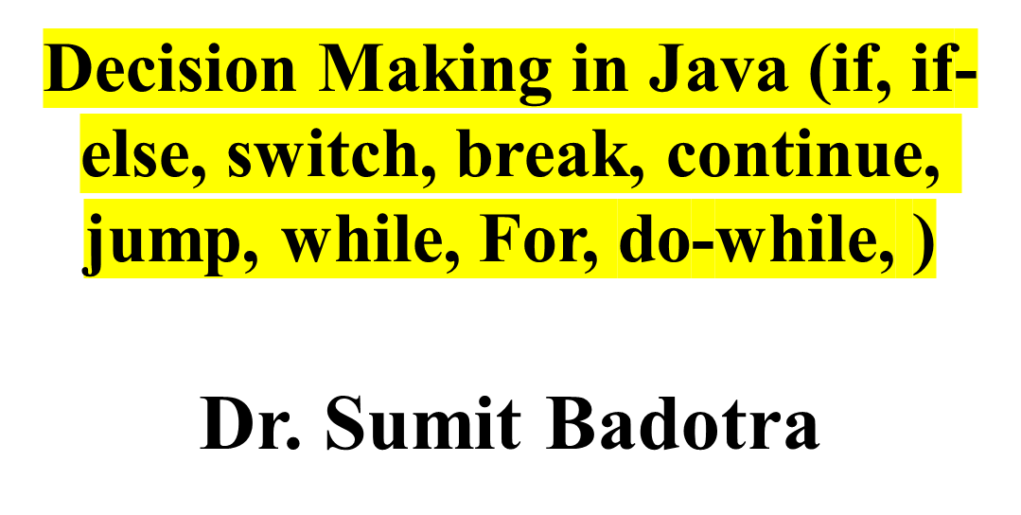
Module -1

Slide 33
Java - General
Decision Making in programming is similar to decision-making in real life.
In programming also face some situations where we want a certain block of code to be executed when some condition is fulfilled.

Slide 34
Java - Selection
Java’s Selection statements:
if
if-else
nested-if
if-else-if
switch-case
jump – break, continue, return

Slide 35
if
if statement is the most simple decision-making statement.
It is used to decide whether a certain statement or block of statements will be executed or not i.e if a certain condition is true then a block of statements is executed otherwise not.

Slide 36
Syntax
if(condition)
{
// Statements to execute if
// condition is true
}

Slide 37
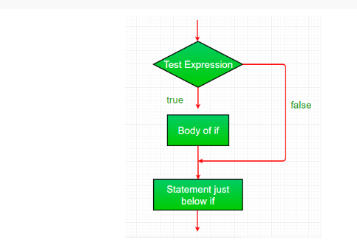
If Condition

Slide 38
Util Package?
util. * is a built-in package in Java which encapsulates a similar group of classes, sub-packages and interfaces.
The * lets you import a class from existing packages and use it in the program as many times you need.

Slide 39
Example
import java.util.Scanner; // Import the Scanner class
class Main {
public static void main(String[] args) {
Scanner myObj = new Scanner(System.in); // Create a Scanner object
System.out.println("Enter username");
String userName = myObj.nextLine(); // Read user input
System.out.println("Username is: " + userName); // Output user input
}
}

Slide 40
How it works…!
import java.util.*;
class IfDemo {
public static void main(String args[])
{
int i = 10;
if (i < 15)
System.out.println("Inside If block"); // part of if block(immediate one statement after if condition)
System.out.println("10 is less than 15"); //always executes as it is outside of if block
// This statement will be executed
// as if considers one statement by default again below statement is outside of if block
System.out.println("I am Not in if");
}
}

Slide 41
If-else
if-else: The if statement alone tells us that if a condition is true it will execute a block of statements and if the condition is false it won’t.
But what if we want to do something else if the condition is false? Here comes the else statement. We can use the else statement with the if statement to execute a block of code when the condition is false.

Slide 42
Syntax
if (condition)
{
// Executes this block if
// condition is true
}
else
{
// Executes this block if
// condition is false
}

Slide 43
Example
// Java program to illustrate if-else statement
import java.util.*;
class IfElseDemo {
public static void main(String args[])
{
int i = 10;
if (i < 15)
System.out.println("i is smaller than 15");
else
System.out.println("i is greater than 15");
}
}

Slide 44
Nested if
nested-if: A nested if is an if statement that is the target of another if or else. Nested if statements mean an if statement inside an if statement.
Yes, java allows us to nest if statements within if statements. i.e, we can place an if statement inside another if statement.

Slide 45
Syntax
if (condition1)
{
// Executes when condition1 is true
if (condition2)
{
// Executes when condition2 is true
}
}

Slide 46
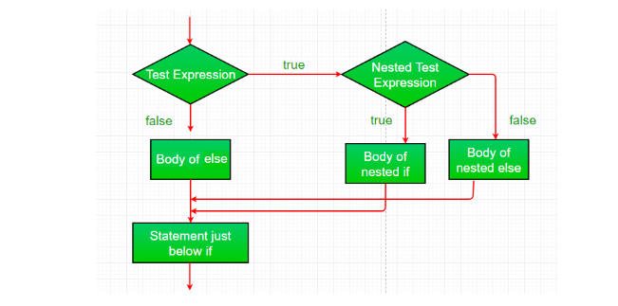
Working

Slide 47
Example
import java.util.*;
class NestedIfDemo {
public static void main(String args[])
{
int i = 10;
if (i == 10 || i<15) {
// First if statement
if (i < 15)
System.out.println("i is smaller than 15");
// Nested - if statement
// Will only be executed if statement above
// it is true
if (i < 12)
System.out.println(
"i is smaller than 12 too");
} else{
System.out.println("i is greater than 15");
}
}
}
Notes:
i is smaller than 15
i is smaller than 12 too

Slide 48
If-else-if
if-else-if ladder: Here, a user can decide among multiple options.The if statements are executed from the top down.
As soon as one of the conditions controlling the if is true, the statement associated with that ‘if’ is executed, and the rest of the ladder is bypassed.
If none of the conditions is true, then the final else statement will be executed.
There can be as many as ‘else if’ blocks associated with one ‘if’ block but only one ‘else’ block is allowed with one ‘if’ block.

Slide 49
Syntax
if (condition)
statement;
else if (condition)
statement;
else
statement;

Slide 50
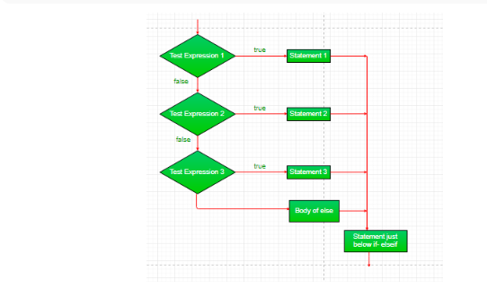
Working

Slide 51
Example
import java.util.*;
class ifelseifDemo {
public static void main(String args[])
{
int i = 20;
if (i == 10)
System.out.println("i is 10");
else if (i == 15)
System.out.println("i is 15");
else if (i == 20)
System.out.println("i is 20");
else
System.out.println("i is not present");
}
}
Notes:
20

Slide 52
Switch-case
switch-case: The switch statement is a multiway branch statement.
It provides an easy way to dispatch execution to different parts of code based on the value of the expression.
Notes:
10+12=22 10+11=21

Slide 53
Syntax
switch (expression)
{
case value1:
statement1;
break;
case value2:
statement2;
break;
case valueN:
statementN;
break;
default:
statementDefault;
}

Slide 54
Example
import java.io.*;
class GFG {
public static void main (String[] args) {
int num=20;
switch(num){
case 5 : System.out.println("It is 5");
break;
case 10 : System.out.println("It is 10");
break;
case 15 : System.out.println("It is 15");
break;
case 20 : System.out.println("It is 20");
break;
default: System.out.println("Not present");
}
}
}

Slide 55
Jump Statements
jump: Java supports three jump statements:
break,
continue
and return.
These three statements transfer control to another part of the program.

Slide 56
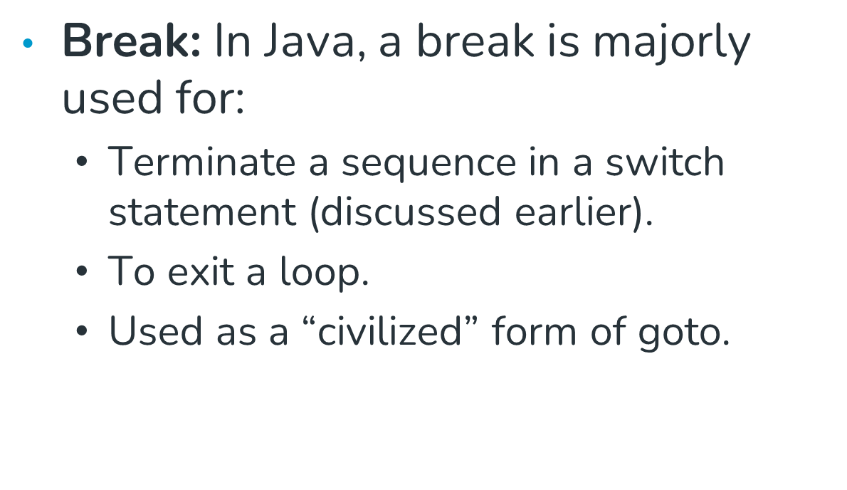
Break
Notes:
21

Slide 57
Continue
Continue: Sometimes it is useful to force an early iteration of a loop. That is, you might want to continue running the loop but stop processing the remainder of the code in its body for this particular iteration.
This is, in effect, a goto just past the body of the loop, to the loop’s end. The continue statement performs such an action.

Slide 58
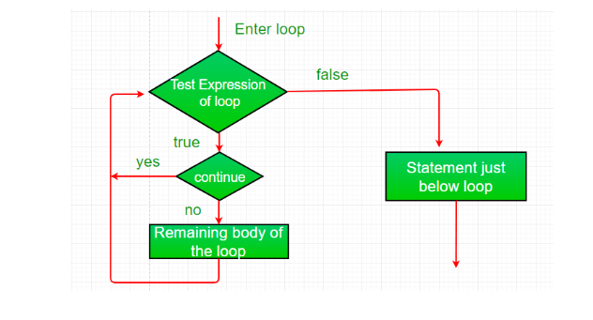
Working

Slide 59
Example
import java.util.*;
class ContinueDemo {
public static void main(String args[])
{
for (int i = 0; i < 10; i++) {
// If the number is even
// skip and continue
if (i % 2 == 0)
continue;
// If number is odd, print it
System.out.print(i + " ");
}
}
}
Notes:
1 3 5 7 9

Slide 60
Return Statement
Return: The return statement is used to explicitly return from a method.
That is, it causes program control to transfer back to the caller of the method.

Slide 61
Example
  // Java program to illustrate using return
  import java.util.*;
  public class Return {
  public static void main(String args[])
  {
  boolean t = true;
  System.out.println("Before the return.");
  if (t)
  return;
  // Compiler will bypass every statement
  // after return
  System.out.println("This won't execute.");
  }
  }
Notes:
Before the return.

Slide 62
while, For, do-while,
The Java do-while loop is used to iterate a part of the program repeatedly, until the specified condition is true.
If the number of iteration is not fixed and you must have to execute the loop at least once, it is recommended to use a do-while loop.

Slide 63
Syntax
do{
//code to be executed / loop body
//update statement
}while (condition);

Slide 64
Do-while example
  public class DoWhileExample {
  public static void main(String[] args) {
  int i=1;
  do{
  System.out.println(i);
  i++;
  }while(i<=10);
  }
  }
Notes:
1 2 3 4 5 6 7 8 9 10

Slide 65
Java Infinitive do-while Loop
If you pass true in the do-while loop, it will be infinitive do-while loop.
Syntax
do{
//code to be executed
}while(true);

Slide 66
Java Infinitive do-while Loop Example
public class DoWhileExample2 {
public static void main(String[] args) {
do{
System.out.println("infinitive do while loop");
}while(true);
}
}
Notes:
infinitive do while loop infinitive do while loop infinitive do while loop ctrl+c

Slide 67
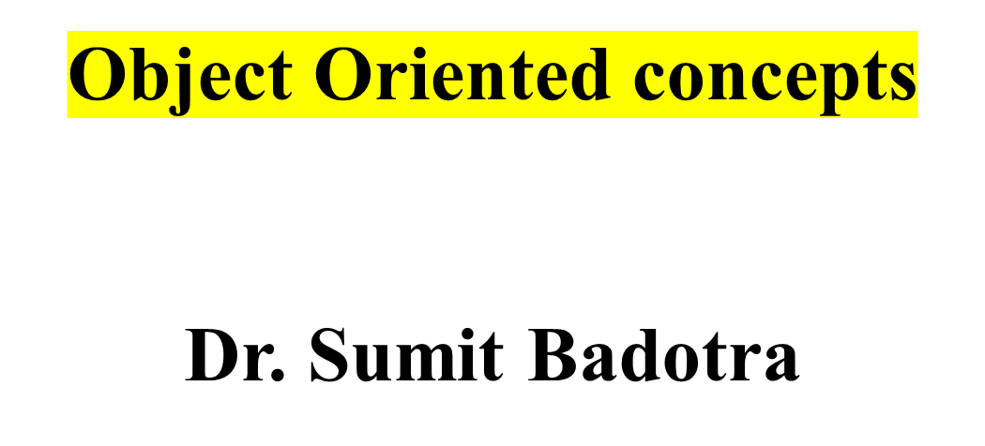
Module -1

Slide 68
OOPs (Object-Oriented Programming System)
Object means a real-world entity such as a pen, chair, table, computer, watch, etc. Object-Oriented Programming is a methodology or paradigm to design a program using classes and objects. It simplifies software development and maintenance by providing some concepts:
Object
Class
Inheritance
Polymorphism
Abstraction
Encapsulation

Slide 69
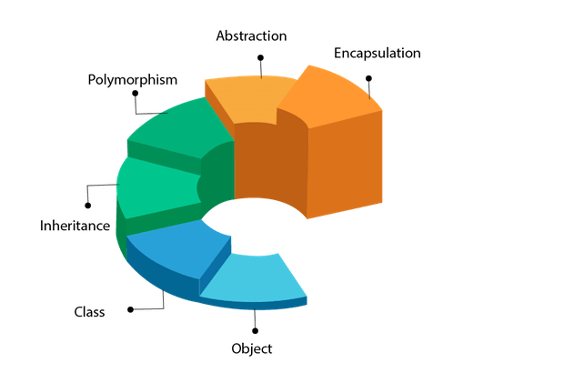
Java -OOPs

Slide 70
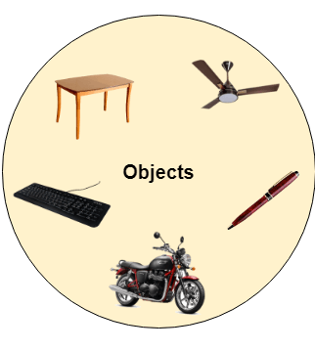
What is Object?
Any entity that has state and behavior is known as an object. For example, a chair, pen, table, keyboard, bike, etc. It can be physical or logical.

Slide 71
What is Class?
Collection of objects is called class. It is a logical entity.
A class can also be defined as a blueprint from which you can create an individual object. Class doesn't consume any space.

Slide 72
Example
// Define a simple class called "Person"
class Person {
String name;
int age;
void introduce() {
System.out.println("Hello, my name is " + name + " and I am " + age + " years old.");
}
}
public class Main {
public static void main(String[] args) {
// Creating objects of the Person class
Person person1 = new Person();
person1.name = "Alice";
person1.age = 30;
Person person2 = new Person();
person2.name = "Bob";
person2.age = 25;
// Calling methods on the objects
person1.introduce(); // Output: Hello, my name is Alice and I am 30 years old.
person2.introduce(); // Output: Hello, my name is Bob and I am 25 years old.
}
}

Slide 73
Example 2
// Define a class called "Rectangle"
class Rectangle {
double length;
double width;
double calculateArea() {
return length * width;
}
double calculatePerimeter() {
return 2 * (length + width); }}
public class Main {
public static void main(String[] args) {
// Creating objects of the Rectangle class
Rectangle rectangle1 = new Rectangle();
rectangle1.length = 5.0;
rectangle1.width = 3.0;
Rectangle rectangle2 = new Rectangle();
rectangle2.length = 7.0;
rectangle2.width = 4.0;
// Calculating and displaying properties of the rectangles
System.out.println("Rectangle 1 Area: " + rectangle1.calculateArea()); // Output: Rectangle 1 Area: 15.0
System.out.println("Rectangle 1 Perimeter: " + rectangle1.calculatePerimeter()); // Output: Rectangle 1 Perimeter: 16.0
System.out.println("Rectangle 2 Area: " + rectangle2.calculateArea()); // Output: Rectangle 2 Area: 28.0
System.out.println("Rectangle 2 Perimeter: " + rectangle2.calculatePerimeter()); // Output: Rectangle 2 Perimeter: 22.0
}
}

Slide 74
What is Inheritance?
When one object acquires all the properties and behaviors of a parent object, it is known as inheritance.
It provides code reusability.
It is used to achieve runtime polymorphism.

Slide 75
What is Polymorphism
If one task is performed in different ways, it is known as polymorphism. For example: to convince the customer differently, to draw something, for example, shape, triangle, rectangle, etc.
In Java, we use method overloading and method overriding to achieve polymorphism.

Slide 76
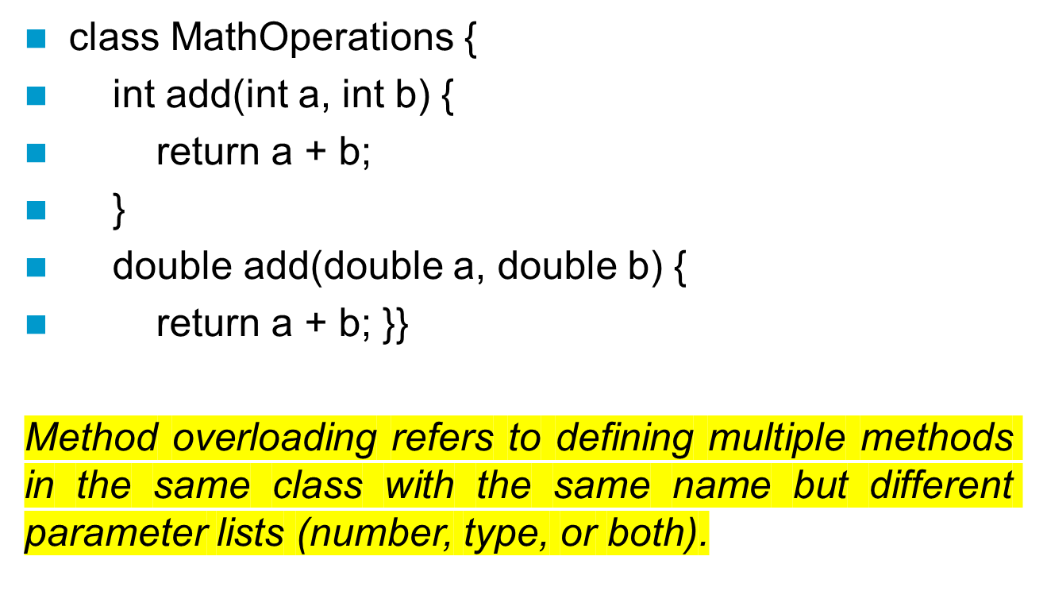
What is Method Overloading

Slide 77
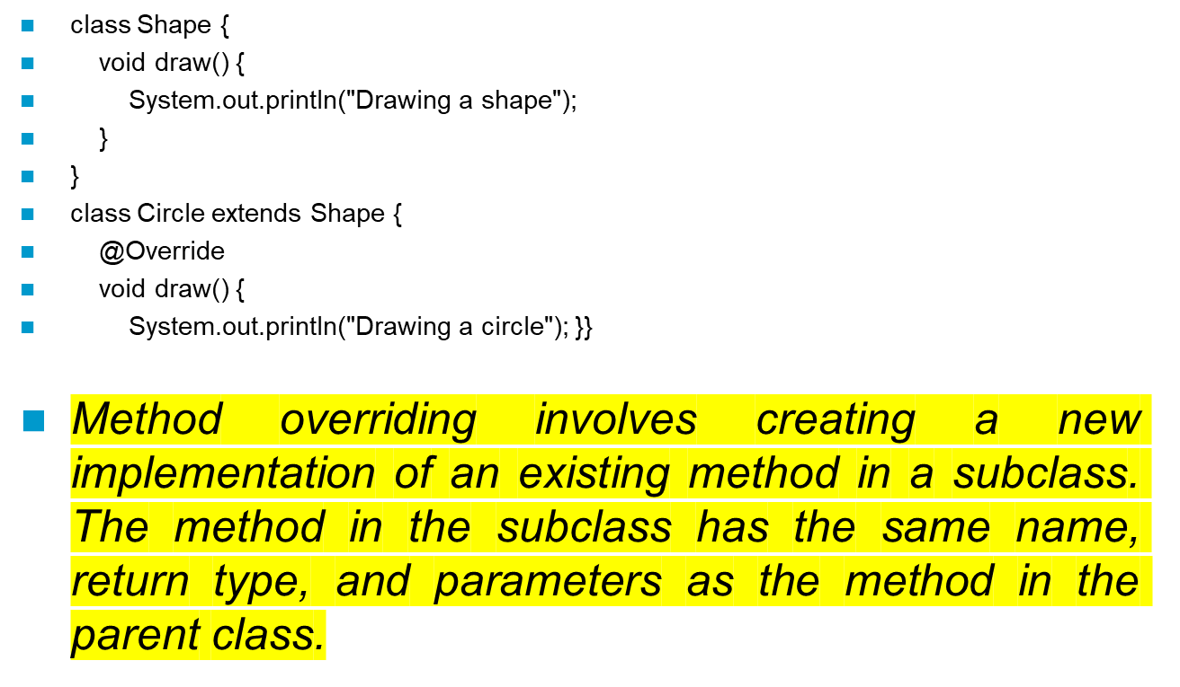
What is Method Overriding

Slide 78
What is Abstraction?
Hiding internal details and showing functionality is known as abstraction. For example phone call, we don't know the internal processing.
In Java, we use abstract class and interface to achieve abstraction.

Slide 79
What is Encapsulation?
Binding (or wrapping) code and data together into a single unit are known as encapsulation. For example, a capsule, it is wrapped with different medicines.
A java class is the example of encapsulation. Java bean is the fully encapsulated class because all the data members are private here.

Slide 80
What is Coupling?
Coupling refers to the knowledge or information or dependency of another class. It arises when classes are aware of each other.
If a class has the details information of another class, there is strong coupling. In Java, we use private, protected, and public modifiers to display the visibility level of a class, method, and field.
You can use interfaces for the weaker coupling because there is no concrete implementation.

Slide 81
What is Cohesion?
Cohesion refers to the level of a component which performs a single well-defined task. A single well-defined task is done by a highly cohesive method. The weakly cohesive method will split the task into separate parts.
The java.io package is a highly cohesive package because it has I/O related classes and interface. However, the java.util package is a weakly cohesive package because it has unrelated classes and interfaces.

Slide 82
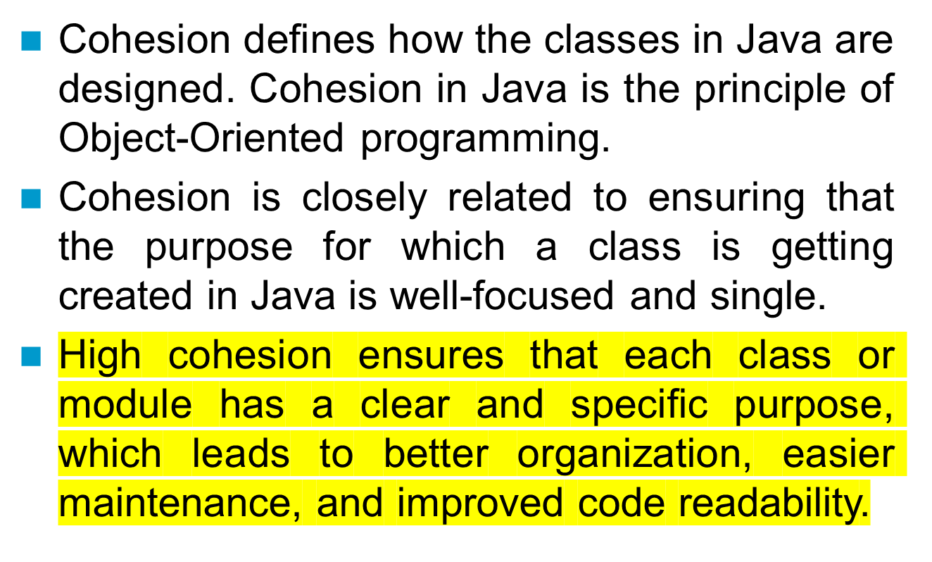
Need of Cohesion?

Slide 83
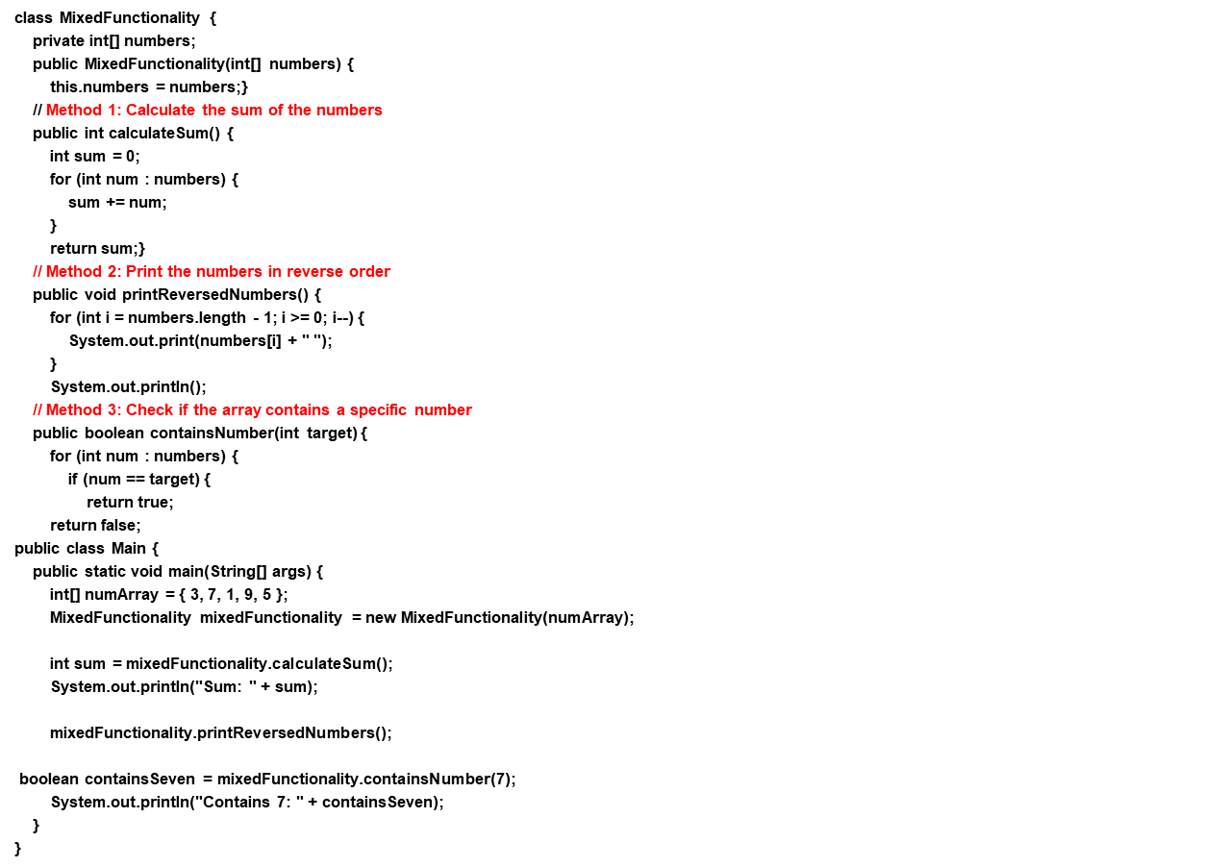
Example of Non-Cohesive program

Slide 84
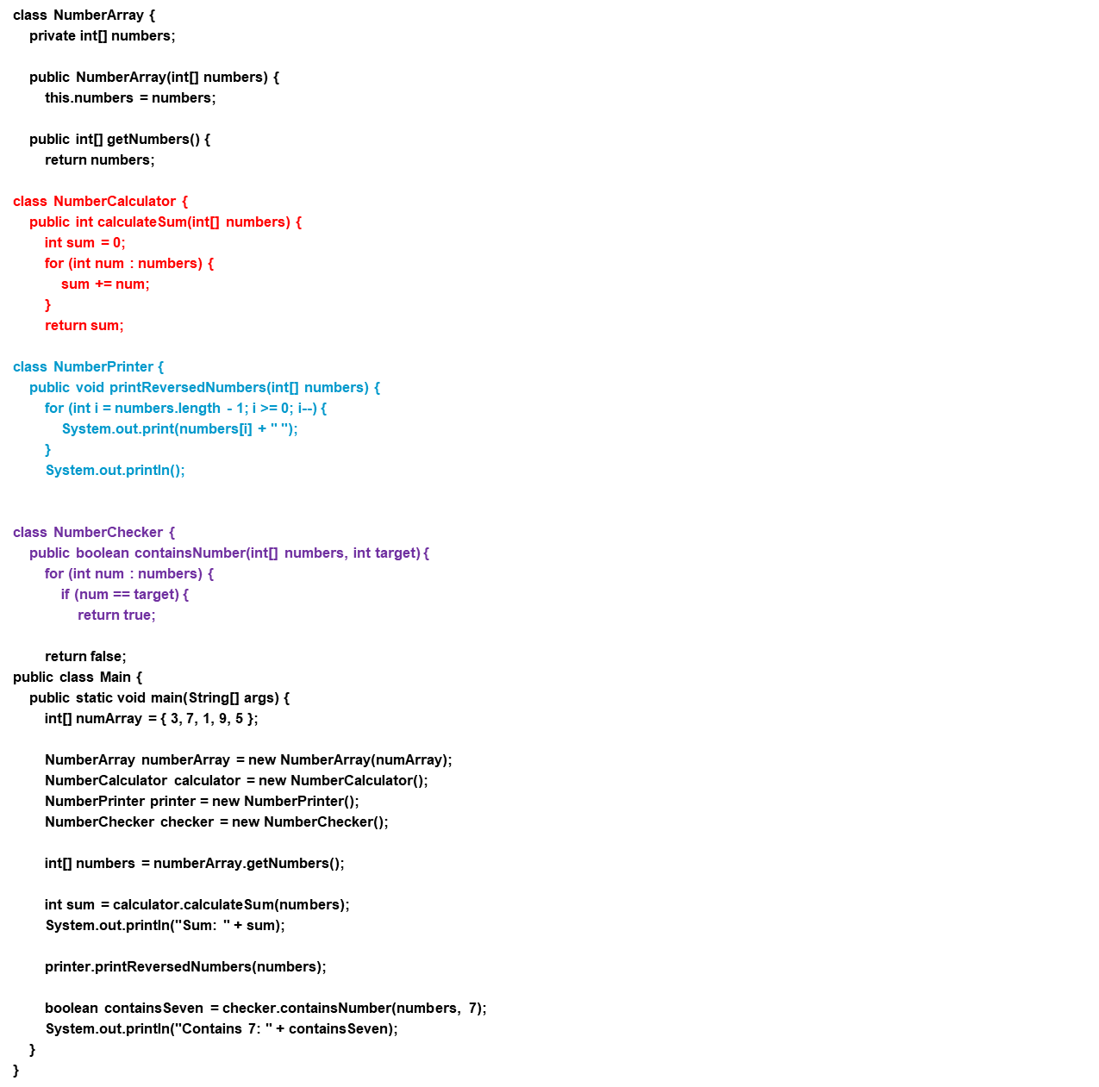
Example of Cohesive program

Slide 85
What is Association?
Association represents the relationship between the objects. Here, one object can be associated with one object or many objects. There can be four types of association between the objects:
One to One
One to Many
Many to One, and
Many to Many

Slide 86
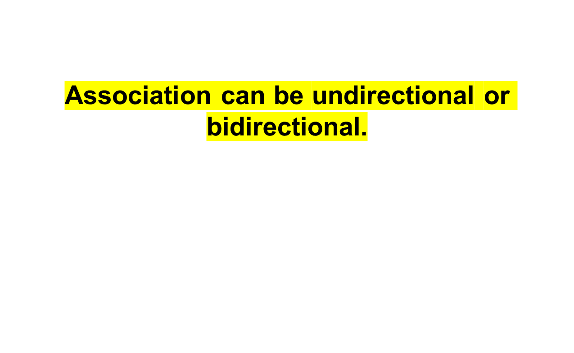

Slide 87
What is Aggregation?
Aggregation is a way to achieve Association. Aggregation represents the relationship where one object contains other objects as a part of its state.
It represents the weak relationship between objects.
It is also termed as a has-a relationship in Java. Like, inheritance represents the is-a relationship.
It is another way to reuse objects.

Slide 88
What is Composition?
The composition is also a way to achieve Association. The composition represents the relationship where one object contains other objects as a part of its state.
There is a strong relationship between the containing object and the dependent object. It is the state where containing objects do not have an independent existence.
If you delete the parent object, all the child objects will be deleted automatically.

Slide 89
Procedural Language
In Procedural programming, the program is divided into small functions. In Object-Oriented Programming, a program is divided into small objects.
Some common examples of Procedural Programming are C, Fortran, VB, and Pascal. The examples of Object Oriented Programmin`g languages are Java, C++, VB.NET, Python, and C#.NET.

Slide 90
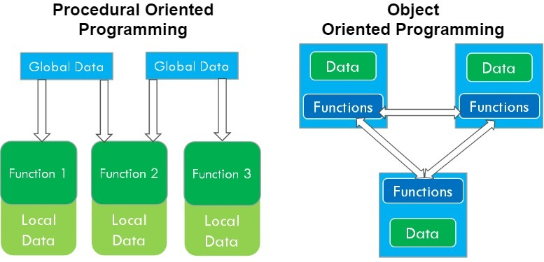
What is the difference?

Slide 91
OOPs Offer
Modularity: Code is organized into objects, enhancing clarity and maintainability.
Reusability: Classes and inheritance enable code reuse, reducing redundancy.
Abstraction: Focuses on essential properties, making code more intuitive.
Polymorphism: Objects of different classes can be treated uniformly.
Maintenance: Changes are localized to objects, reducing unintended side effects.
Collaboration: Facilitates team development with reduced code conflicts.
Real-World Mapping: Models real-world concepts, enhancing problem domain alignment.
Security: Controls data access through private and protected modifiers.
Simplicity: Mirrors natural problem-solving, leading to more intuitive solutions.

Slide 92
Object Lifecycle
Creation: Object is born, memory allocated, attributes initialized.
Usage: Object actively used, methods and attributes utilized.
References: Object referenced by variables, stays in scope.
Dereference: Object no longer referenced, becomes eligible for cleanup.
Garbage Collection: JVM reclaims memory, removes unused objects.
Finalization: Optional cleanup before object removal (not commonly used).

Slide 93
Example
class Person {
String name;
Person(String name) {
this.name = name;
System.out.println(name + " is created.");
}
void introduce() {
System.out.println("Hello, my name is " + name + ".");
}
protected void finalize() throws Throwable {
System.out.println(name + " is being finalized.");
super.finalize();}}
public class Main {
public static void main(String[] args) {
Person person1 = new Person("Alice"); // Creation
person1.introduce(); // Usage
Person person2 = new Person("Bob"); // Creation
person2.introduce(); // Usage
person1 = null; // Dereference
System.gc(); // Suggesting garbage collection
person2.introduce(); // Usage
// At the end of the program, when it's about to exit:
// Garbage collector may finalize person1 and person2
}
}

Slide 94
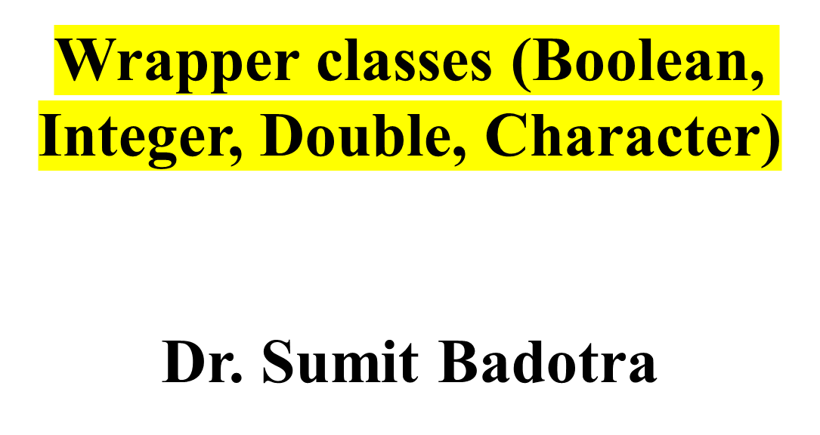
Module -1

Slide 95
Wrapper Class
A Wrapper class in Java is a class whose object wraps or contains primitive data types. When we create an object to a wrapper class, it contains a field and in this field, we can store primitive data types

Slide 96
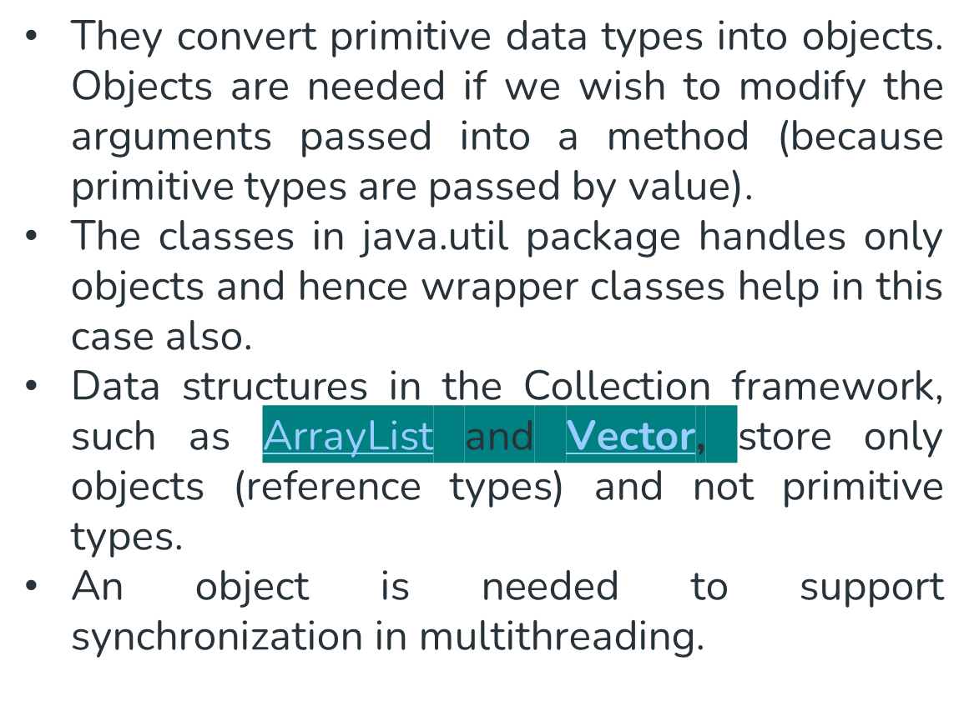
Need of Wrapper Classes

Slide 97
Advantages
Collections allowed only object data.
On object data we can call multiple methods compareTo(), equals(), toString()
Cloning process only objects
Object data allowed null values.
Serialization can allow only object data.

Slide 98
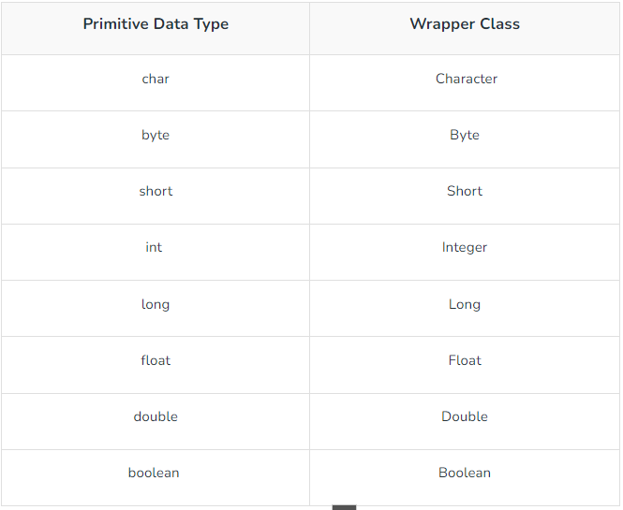
Difference?

Slide 99
Autoboxing?
Autoboxing is the automatic conversion that the Java compiler makes between the primitive types and their corresponding object wrapper classes.
For example, converting an int to an Integer, a double to a Double, and so on.

Slide 100
Example
//Java program to convert primitive into objects
//Autoboxing example of int to Integer
public class WrapperExample1{
public static void main(String args[]){
//Converting int into Integer
int a=20;
Integer i=Integer.valueOf(a);//converting int into Integer explicitly
Integer j=a;//autoboxing, now compiler will write Integer.valueOf(a) internally
System.out.println(a+" "+i+" "+j);
}}

Slide 101
Example 2
import java.io.*;
class GFG {
public static void main(String[] args)
{
// Creating an Integer Object
// with custom value say it be 10
Integer i = new Integer(10);
// Unboxing the Object
int i1 = i;
System.out.println("Value of i:" + i);
System.out.println("Value of i1: " + i1);
// Autoboxing of character
Character gfg = 'a';
// Auto-unboxing of Character
char ch = gfg;
// Print statements
System.out.println("Value of ch: " + ch);
System.out.println(" Value of gfg: " + gfg);
}
}

Slide 102
Unboxing
The automatic conversion of wrapper type into its corresponding primitive type is known as unboxing. It is the reverse process of autoboxing.
Since Java 5, we do not need to use the intValue() method of wrapper classes to convert the wrapper type into primitives.

Slide 103
Example
/Java program to convert object into primitives
//Unboxing example of Integer to int
public class WrapperExample2{
public static void main(String args[]){
//Converting Integer to int
Integer a=new Integer(3);
int i=a.intValue();//converting Integer to int explicitly
int j=a;//unboxing, now compiler will write a.intValue() internally
System.out.println(a+" "+i+" "+j);
}}

